Slide 1
Embedded Ethics: Disability and
Software Accessibility
Module 1
Notes:
Licensed by the University of Toronto Embedded Ethics Education Initiative, Lindsey Shorser, Jonathan Calver and Paul Gries under the Attribution-NonCommercial-ShareAlike 4.0 International license. To view a copy of this license, visit https://creativecommons.org/licenses/by-nc-sa/4.0/.
Photo by Vitaly Vlasov from Pexels (https://www.pexels.com/photo/person-pointing-numeric-print-1342460/)
Photo by Charl Durand from Pexels (https://www.pexels.com/photo/the-thinker-statue-in-rodin-museum-france-6486112/)

Slide 2
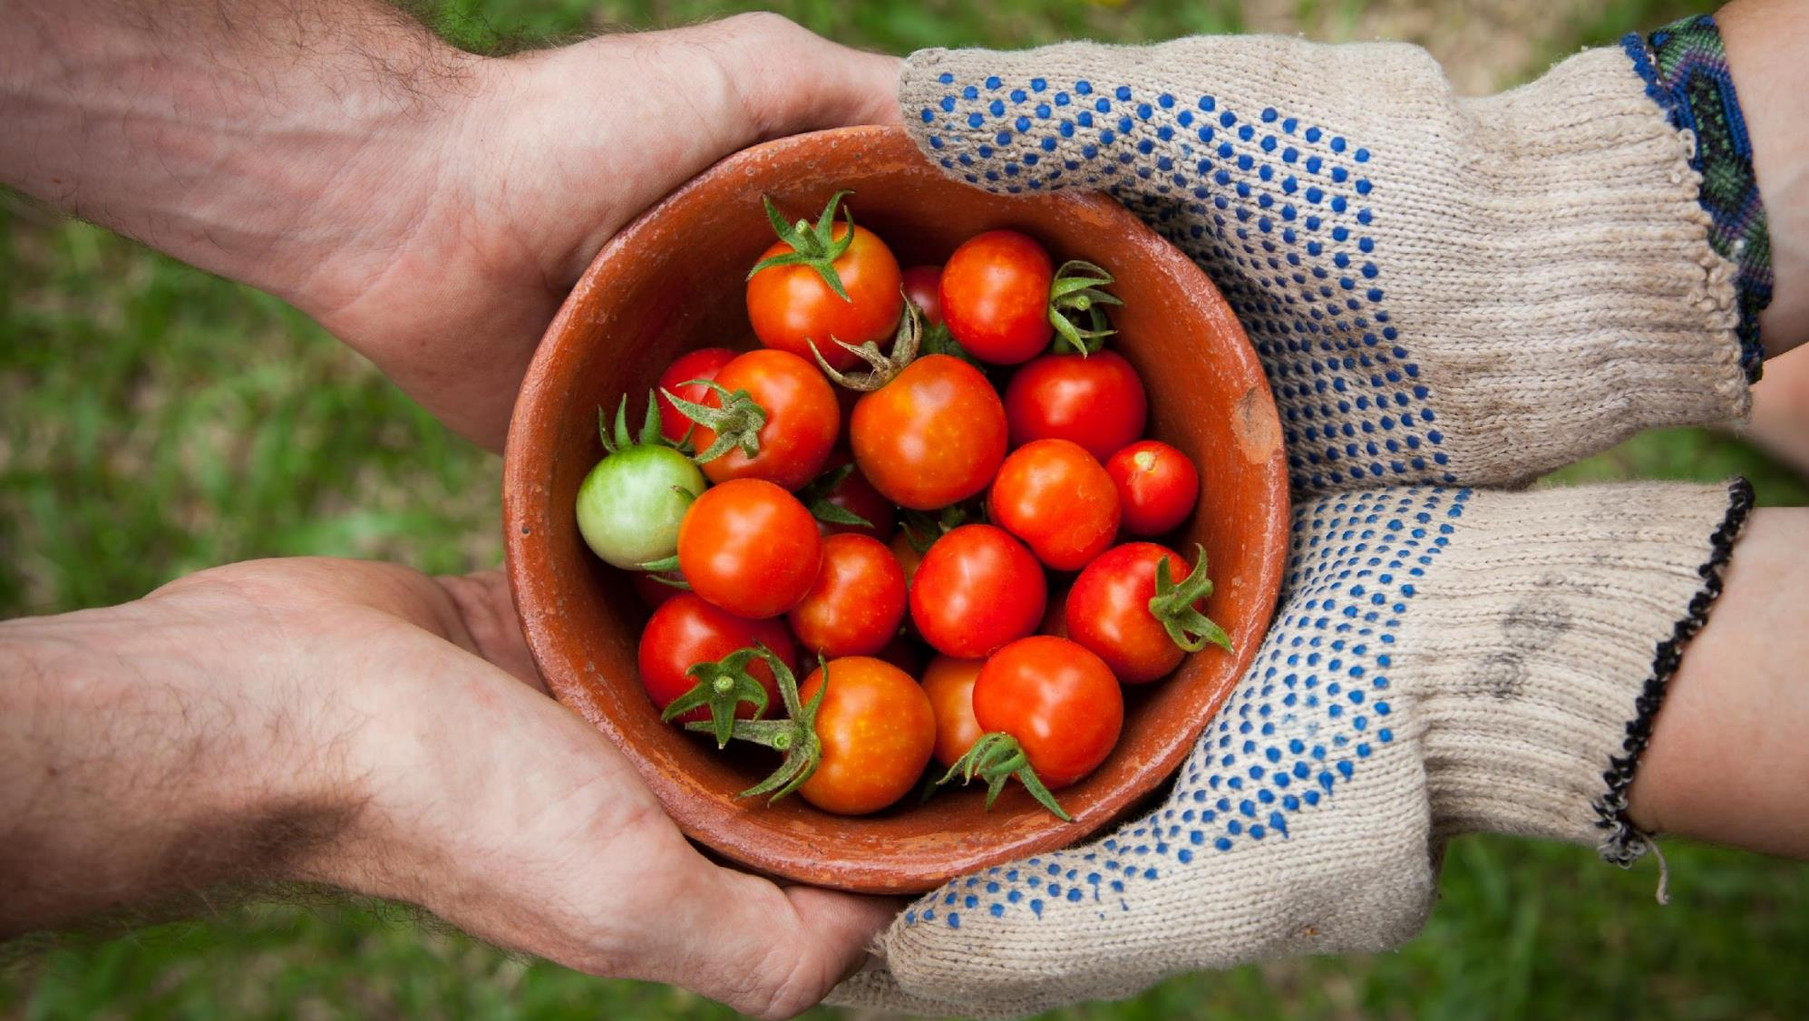
Distributive Justice
Any case in which it is not possible to give everyone as much as they would want raises ethical questions of distributive justice.
Photo by Elaine Casap on Unsplash
Notes:
Image Source: Photo by Elaine Casap on Unsplash
Licensed by the University of Toronto Embedded Ethics Education Initiative, Nisarg Shah and Deepanshu Kush under the Attribution-NonCommercial-ShareAlike 4.0 International license. To view a copy of this license, visit https://creativecommons.org/licenses/by-nc-sa/4.0/.

Slide 3
Inheritance
When a person passes away, their property is transferred to other people in their life.
In some cases, they leave a will that specifies to whom their property should be given.
When there is no will, how should their property be distributed?
Notes:
Image Source: Scott Graham at unsplash (https://unsplash.com/photos/OQMZwNd3ThU)

Slide 4
Organ Transplants
Organ transplants are a clear example of distributive justice.
There are usually more people who need organs than organs available.
How do we decide who should get the limited supply of organs?
Notes:
Image Source: Mehmet Turgut Kirkgoz at Unsplash (https://unsplash.com/photos/0ZcDPrBqCco)

Slide 5
Bonuses at Work
At some workplaces, the management will give bonuses to employees after a successful year.
How should the bonuses be given out to employees? Should some receive a greater bonus than others?
Notes:
Image Source: Sora Shimazaki at Pexels (https://www.pexels.com/id-id/foto/foto-orang-yang-memegang-tagihan-5926444/)

Slide 6
Justice and Fairness
Ethics asks two questions:
Are there ways of distributing these resources that are ‘unjust’ or ‘unfair’?
E.g. You shouldn’t give the whole inheritance to just one person!
While many people become upset when they do not get what they want, if a decision really is unjust or unfair, they would be entitled to feel upset.
Is there some ‘just’ or ‘fair’ way that we should distribute these resources?
Notes:
Background Image Source: Photo by Clay Banks on Unsplash

Slide 7
Relativism
Of course, people will disagree about which of these factors matter. But are their answers just a matter of opinion?
One reason to think that moral questions are not just a matter of opinion is our intuitive response to being wronged by another person.
Another reason is that it is possible to craft arguments about fairness.
Ethics?
Notes:
Background Image Source: Photo by Clay Banks on Unsplash
Image 1 Source: Any Late at Pixels (https://www.pexels.com/photo/fresh-cut-pineapple-on-table-5945754/)
Image 2 Source: stevepb at pixabay (https://pixabay.com/photos/calculator-calculation-insurance-385506/)

Slide 8
Crafting Arguments about Fairness Primary Stakeholders
To make an argument that some distribution is fair, we can begin by looking at the perspectives of the primary stakeholders who might receive resources.
For example, in the inheritance case, you might identify the different people who might be eligible to receive inheritance:
Children
Spouses
Notes:
Image 1 Source: Alexander Dummer at Pexels (https://www.pexels.com/photo/photo-of-toddler-smiling-1912868/)
Image 2 Source: Lollipop Photography UK at Pixabay
Background Image Source: Image by Peggy Choucair from Pixabay (https://pixabay.com/photos/glass-sphere-landscape-bullet-glass-3931999/)

Slide 9
Crafting Arguments about Fairness: Primary Stakeholders
One argument that a distribution is fair or just is that it takes into account the positions of all of these primary stakeholders.
In other words, you need to be able to imagine justifying your decision to each internal stakeholder.
This does not necessarily mean giving them equal shares.
However, it does mean that any valid claim from an internal stakeholder should be acknowledged in the distribution.
When justifying a distribution to the stakeholders, we will use the following ‘building blocks’.
Notes:
Background Image Source: Image by Peggy Choucair from Pixabay (https://pixabay.com/photos/glass-sphere-landscape-bullet-glass-3931999/)

Slide 10
Building Blocks of a Theory of Fairness
Efficiency: making sure resources are allocated where they are used most effectively.
Rights to a minimum: making sure everyone has a bare minimum needed to survive, thrive, etc.
Efficiency
Desert: making sure people get what they deserve (e.g. because they have worked for it)
Equality: making sure everyone gets the same amount of resources, or that no one receives more or less for arbitrary reasons.
Notes:
Background Image Source: Photo by Clay Banks on Unsplash
Photo Sources (from top left, counter-clockwise):
Image 1 Source: Marvin Meyer at unsplash (https://unsplash.com/photos/SYTO3xs06fU)
Image 2 Source: https://pixabay.com/photos/people-male-dirty-hand-palm-2594449/
Image 3 Source: Clay Banks at unsplash.com (https://unsplash.com/photos/qT7fZVbDcqE)
Image 4 Source: Thought Catalogue on unsplash.com (https://unsplash.com/photos/fnztlIb52gU)

Slide 11
Egalitarianism
Zooming in on Equality
Assign resources equally.
Equality: making sure that everyone gets the same amount of resources, or that no one receives more or less for arbitrary reasons.
Sexuality
Race
Gender
Disability
Other context-specific factors
Notes:
Background Image Source: Photo by Clay Banks on Unsplash
Image Source: Clay Banks at unsplash.com (https://unsplash.com/photos/qT7fZVbDcqE)

Slide 12
Back to the Inheritance Case
Equality: making sure that everyone gets the same amount of resources, or that no one receives more or less for arbitrary reasons.
$200,000
$1,000,000
Rights to a minimum: making sure that everyone has a bare minimum needed to survive, thrive, etc.
$200,000
Desert: making sure people get what they deserve (e.g. because they have worked for it)
$600,000
Notes:
Background Image Source: Photo by Clay Banks on Unsplash
Image 1 Source: Alexander Dummer at Pexels (https://www.pexels.com/photo/photo-of-toddler-smiling-1912868/)
Image 2 Source: Lollipop Photography UK at Pixabay
Image 3 Source: https://pixabay.com/photos/people-male-dirty-hand-palm-2594449
Image 4 Source: Clay Banks at unsplash.com (https://unsplash.com/photos/qT7fZVbDcqE)
Image 5 Source: Thought Catalogue on unsplash.com (https://unsplash.com/photos/fnztlIb52gU)

Slide 13
Crafting Arguments about Fairness: Primary Stakeholders
In the other examples (organ transplants, bonuses), the relevant factors might be different.
E.g. In the bonuses case, perhaps what people deserve (based upon how hard they’ve worked) is much more important!
Desert: making sure people get what they deserve (e.g. because they have worked for it)
Notes:
Background Image Source: Image by Peggy Choucair from Pixabay (https://pixabay.com/photos/glass-sphere-landscape-bullet-glass-3931999/)
Image 1 Source: Sora Shimazaki at Pexels (https://www.pexels.com/id-id/foto/foto-orang-yang-memegang-tagihan-5926444/)
Image 2 Source: https://pixabay.com/photos/people-male-dirty-hand-palm-2594449/

Slide 14
Crafting Argument about Fairness: Secondary Stakeholders
We can also craft other arguments about a fair distribution by looking at secondary stakeholders who do not necessarily receive resources themselves, but instead have relevant expertise or knowledge about the situation.
Notes:
Background Image Source: Image by Peggy Choucair from Pixabay (https://pixabay.com/photos/glass-sphere-landscape-bullet-glass-3931999/)

Slide 15
Crafting Argument about Fairness: Secondary Stakeholders
Secondary stakeholders may help to reveal other limits on a fair distribution.
E.g. a family counselor might know which ways of distributing the inheritance would cause harm to family bonds
Secondary stakeholders may also provide information that is necessary to assess or put into practice the claims of the primary stakeholders.
E.g. a financial planner might know the minimum inheritance required for a reasonably comfortable, secure future.
Notes:
Background Image Source: Image by Peggy Choucair from Pixabay (https://pixabay.com/photos/glass-sphere-landscape-bullet-glass-3931999/)

